Slide 1
Math Analysis
Nicole Ostrander

Slide 2
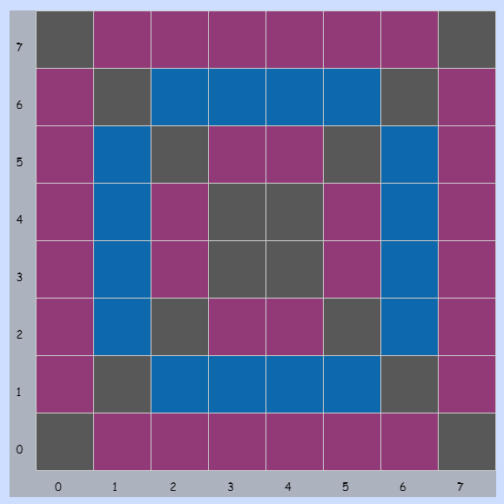
01_PATTERNS
Notes:
So this was my first pattern in the grid, and it was basically just a random design.

Slide 3
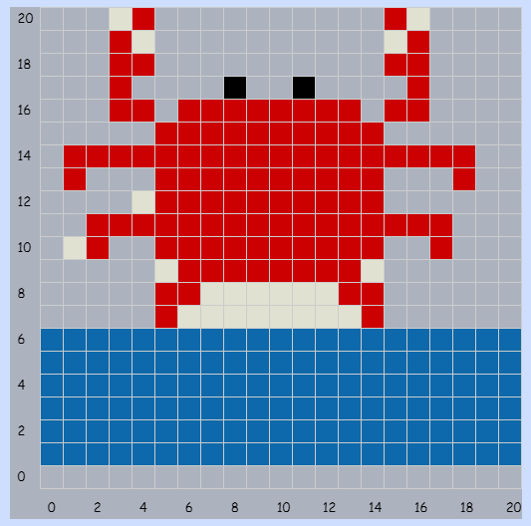
02_PIXELART
Notes:
This was also in the grid, and is basically just like a crab thing that I had tried to design to present in class.

Slide 4
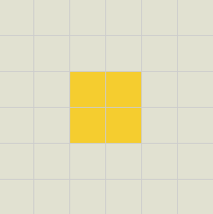
03_FIRSTSAVE
Notes:
This one... I'm not too proud of now but it was my first save in bricklayer lite.

Slide 5
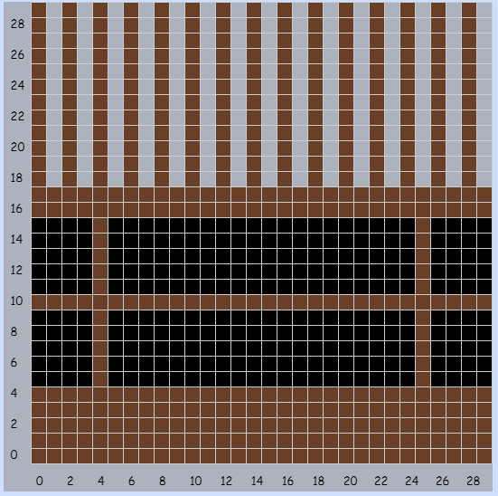
05_Objects around bhs
Notes:
This was done in the grid and was suppose to be that wall thing in the cafeteria.

Slide 6
06_name project
Notes:
Me and Emily had to work together because of the shortage of computers. We used level one because we were still hesitant to use the other levels. It took FOREVER to make the background with like a million 4x2 blocks or whatever I used. It would've been way easier to use level 3 now that I know how to use all that jazz.

Slide 7
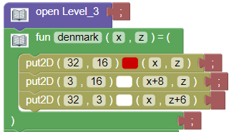
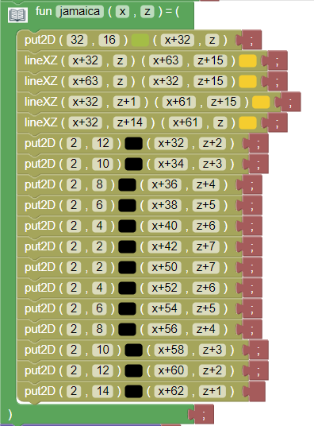
07_FLAG PROJECT
Notes:
This is the code for the flag project which was one of the first ones we did in bricklayer lite. Here I actually used functions instead of just placing stuff where it goes. I also learned how to use the X and Y coordinates which helped me eventually repeat the flags in different areas. Now that I know what I'm doing it would've been way easier to like put a function in a funcion instead of repeating these two functions a million times.

Slide 8
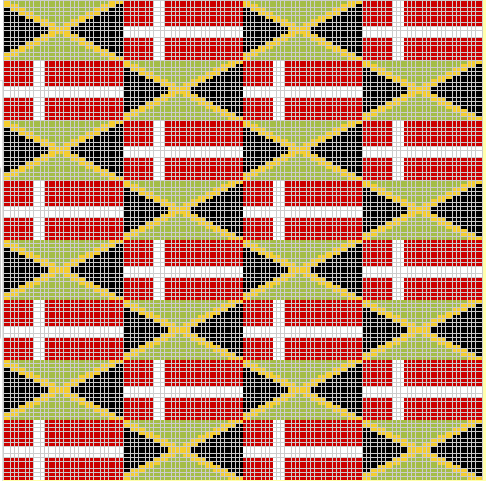
07_FLAG PROJECT
Notes:
This was the end project for my flags in bricklayer lite. The thing I thought was the coolest wasthe line tool, so instead of using like 1x1 blocks I was able to strech a whole line from corner to corner. I then was able to make the lines thick like I did with the white lines on the red flag. So basically the line tool was a lifesaver when creating this patter/flags.

Slide 9
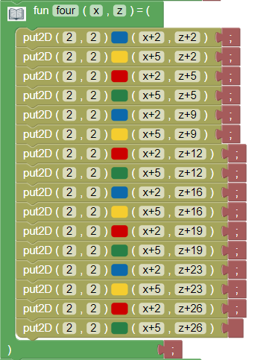
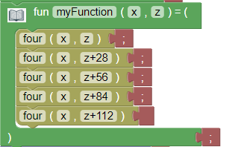
08_MORE PATTERNS
Notes:
This was the code for one the patterns that Cuddy had put on the board. I was able to create little blocks of four going up, and then repeat that to create the line reaching all the way to the top. Here is when I finally put a function inside of a function and was then able to use less code to fill the entire grid.

Slide 10
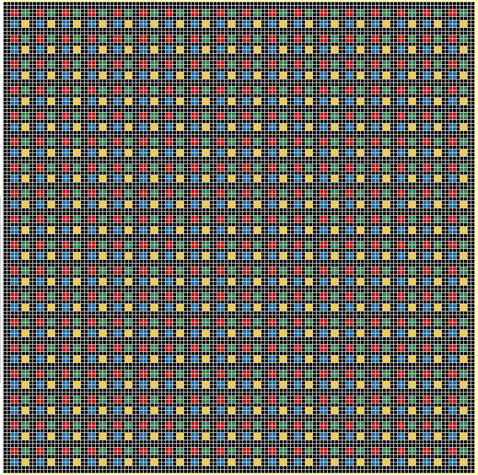
08_MORE PATTERNS
Notes:
This was the end product for the previous code. There's like a million ways people could choose to code this so just by looking at it you can't really tell if I did rows or columns or any of that. This is one of the ones that I thought was cooler just because of the way the end designed looked.

Slide 11
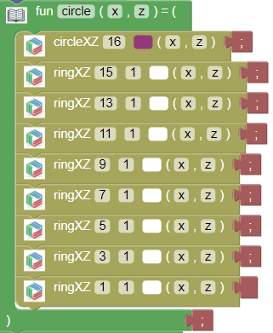
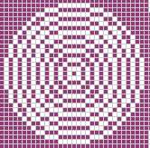
10_ring circle pattern
Notes:
This was the first like step or bit of code that I used to start out when making the pattern. Instead of like doing ring after ring after ring, etc. I made one circle and laid the rings over the top. I ended up using this piece a lot to create columns, and rows, and all of that jazz.

Slide 12
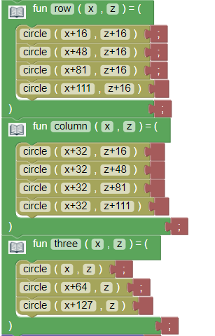
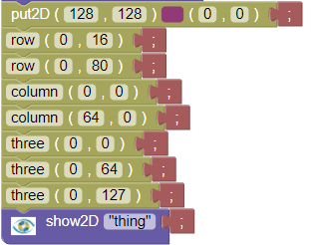
10_Ring circle pattern
Notes:
This was the next steps I used when creating the pattern. I basically made the rows, which I ended up repeating at the end. I also repeated it the same way except in a column. Then the last one "three" was the three circles that were just repeated in the middle of the pattern. My favorite part about this was the use of the X and Y just because it made it way easier to move and place stuff throughout the whole process.

Slide 13
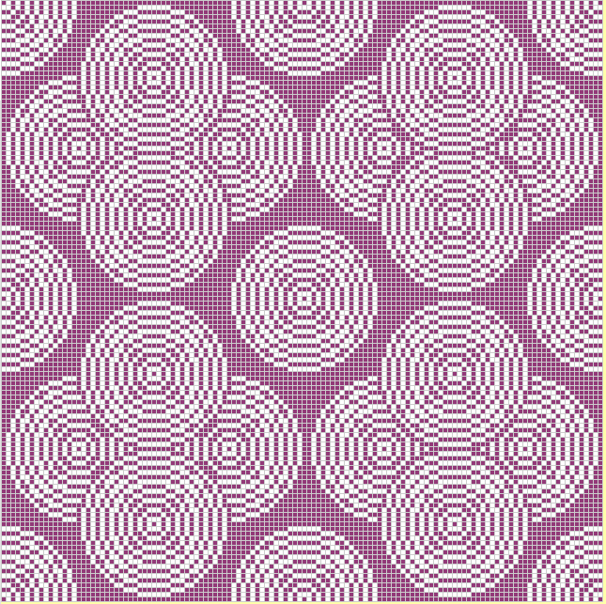
10_RING CIRLCE PATTERN
Notes:
This is the end process for the whole circle pattern. I had previously done the whole thing and ended up bring in internet explorer soooo I had the redo the whole thing which is why there's that little mess up in the top right pattern when compared to the top left.

Slide 14
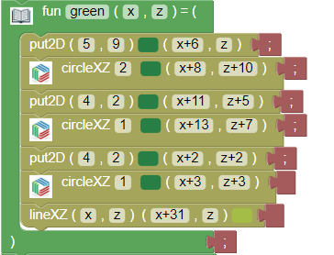
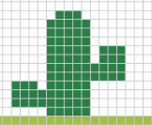
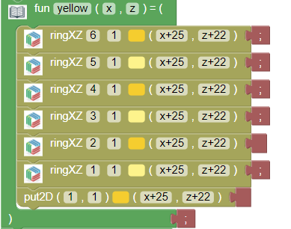

11_ALL FUNCTIONS
Notes:
This was the beginning code for the project that we were supposed to use all of the available functions in level 3. I started out with naming them as their color just so when/if people tried to repeat it, it would be easy to know what is going on.

Slide 15
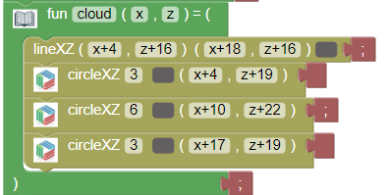

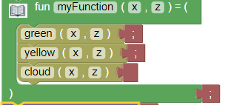
11_all functions
Notes:
I then did another piece of code to add like the cloud. I'm not really sure why I didn't name it, it's color like the other ones but it's still easy to read it and understand what that code is representing. I then put those three functions together to create the whole image.

Slide 16
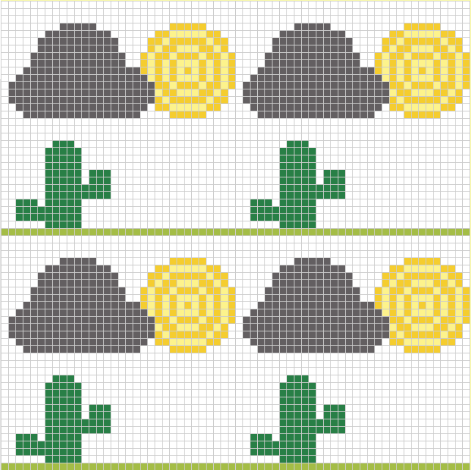
11_ALL FUNCTIONS
Notes:
After putting the code together I was able to repeat it to make it a pattern. This one ended up taking me forever because I did like three different patterns before this and just wasn't excited about them. This one is probably one of my favorites that I created while using bricklayer lite.

Slide 17
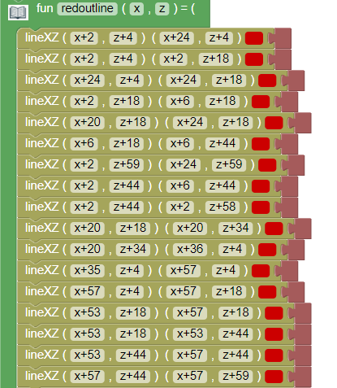
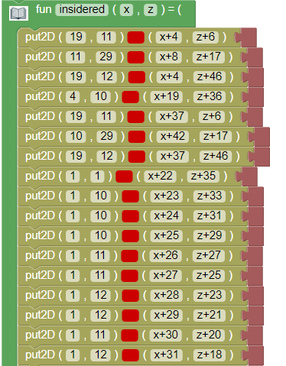
12_REAL IMAGE
Notes:
This was the code to the Nebraska "N" that I was doing for the real image project. I started out with doing the outline of the whole thing in one function, and creating the inside of it. Ok I ended up messing up on a part and I couldn't figure out what part or line or whatever that I had messed up and I didn’t want to delete the whole thing or anything like that.

Slide 18
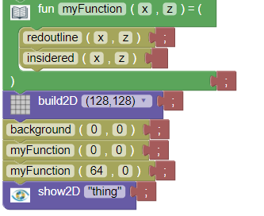
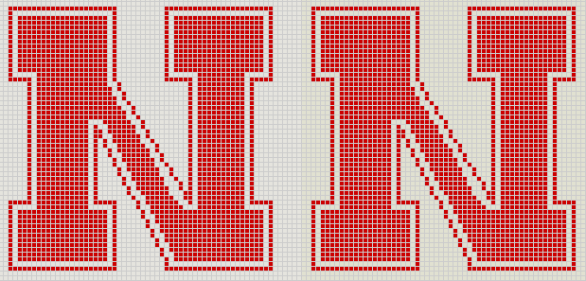
12_REAL IMAGE
Notes:
I then put those functions inside one so I could make it repeatable. It's kind of ugly but you know

Slide 19
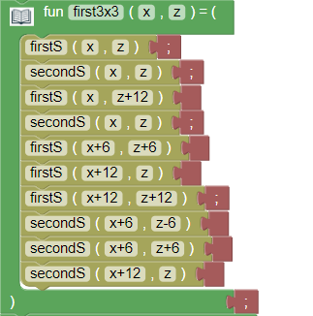
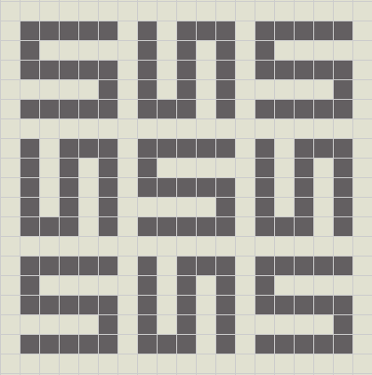
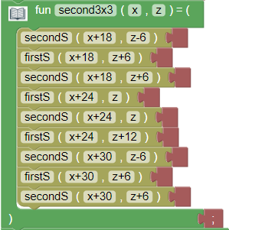
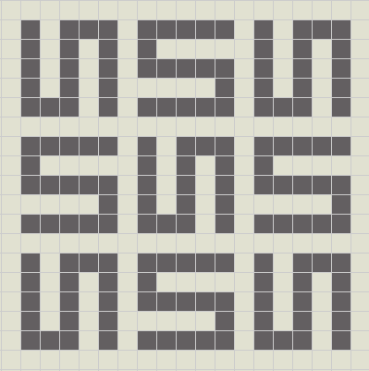
13_SPACE FILLING CURVES
Notes:
This is the beginning parts of how I started the space filling curves. I made two little 3x3's that included the two patterns that I used. I first created the individual "S"'s which were functions that I put inside other functions.

Slide 20
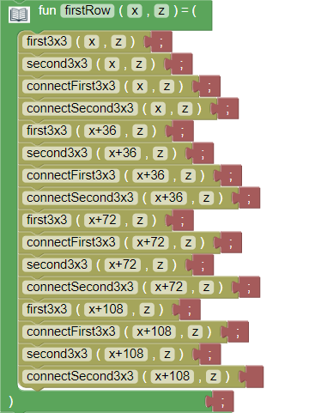
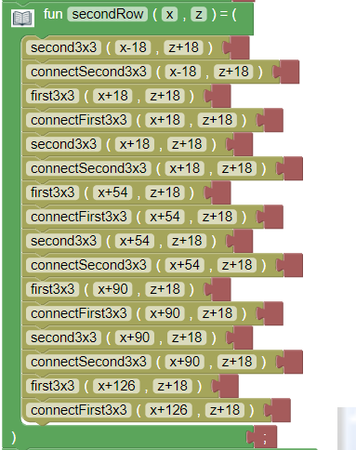
13_space filling curves
Notes:
I was then able to put those 3x3 functions inside to create the rows, which had to be different to connect correctly. Inside these you can see that there's some called "connectSecond3x3" and "ConnectFirst3x3" which are just 1x1's inside of function that I used to connect each "S".

Slide 21
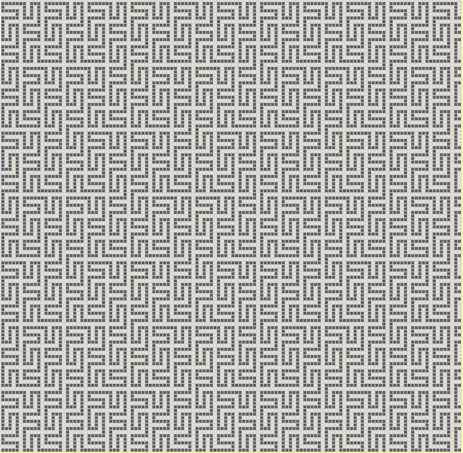
13_space filling curves
Notes:
After all that code I finally got to this end product. I did add a couple 1x1's up at the top so it would have that like ending look while at continues on the rows to the right. This is also one of the cooler ones just because of the look it has and it's weird to think I did it with only basically placing blocks.

Slide 22
The End

